Slide 1
Android
Version 1

Slide 2
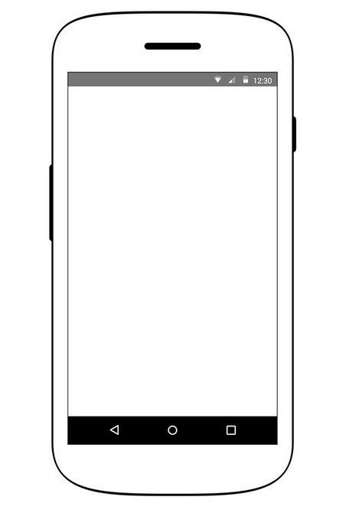
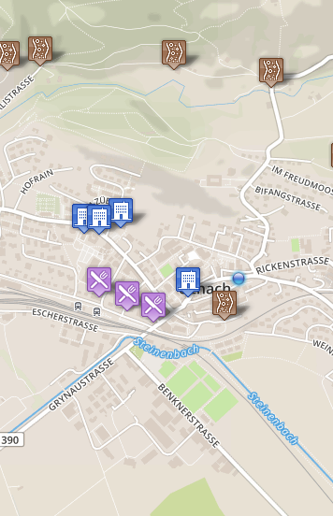

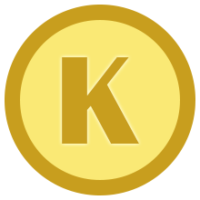
Challenges
Type of track unknow...
What kind of track is this?
Gravel ▼
5 Koins
Dismiss
Answer
Challenges
Profile
Highscore
About
Challenges
Profile
Highscore
About

Slide 3
Highscore
wie zu eigenem Eintrag/Top springen?
Tab Bar
Floating Buttons
Toolbar Buttons
Score
Top
1 | SKRELL | 22720
 | MISSIONS: 2558 CHECKS: 1143 | KOINS
Challenges
Profile
Highscore
About
Challenges
Profile
Highscore
About

Slide 4
Profile
Challenges
Profile
Highscore
About

Slide 5
About
Challenges
Profile
Highscore
About

Slide 6
Settings?

Slide 7
Navigation Drawer?
stattdessen Bottom Tab Bar? (https://www.google.com/design/spec/patterns/navigation.html#navigation-patterns)
Challenges
Dominic Mülhaupt
dominicmh@gmail.com
Challenges
Highscore
Profile
About

